Slide 1
Data Encryption Standard (DES)

Slide 2
Briefing on DES
DES is a block cipher.
Block Size = 64 bit and Key Length = 56 bit.
The initial key consists of 64 bits. But every 8th bit of the key is discarded to produce a 56-bit key.
DES consists of both substitution and transposition.
Broadly, DES consists of 16 steps, each of which is called as a round.

Slide 3
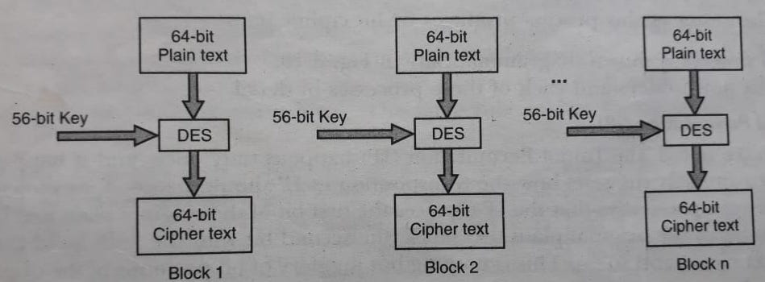
Conceptual Working of DES

Slide 4
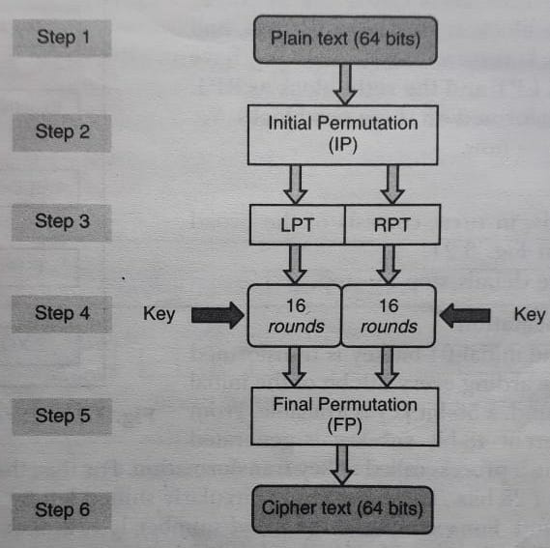
Broad-Level Steps in DES

Slide 5
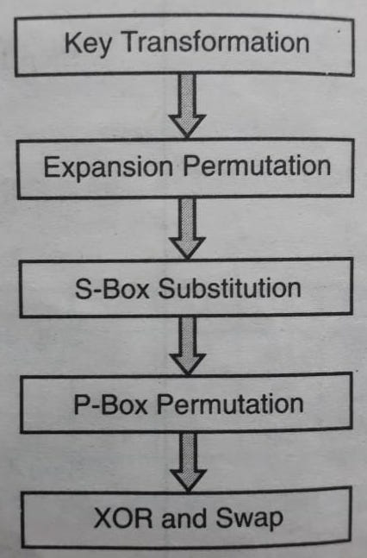
Outline of one Round in DES

Slide 6
Key Transformation
56-bit key is divided into two halves of 28-bit each.
Depending on the round number each halves are circularly shifted left by 2 or 1 position.
Then out of 56 bits , 48 bits are selected by a compression permutation.

Slide 7
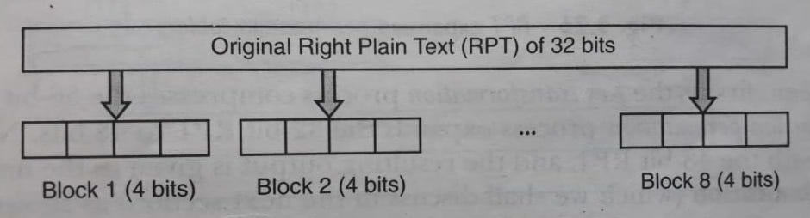
Expansion Permutation (1/2)

Slide 8
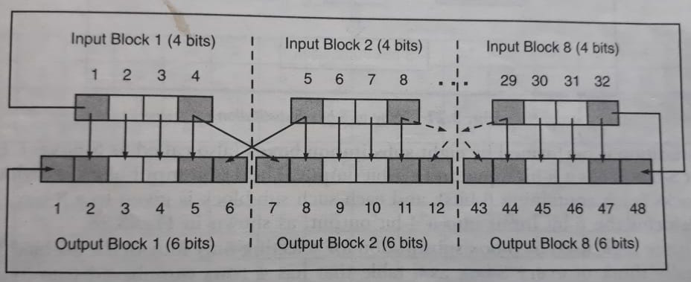
Expansion Permutation (2/2)

Slide 9
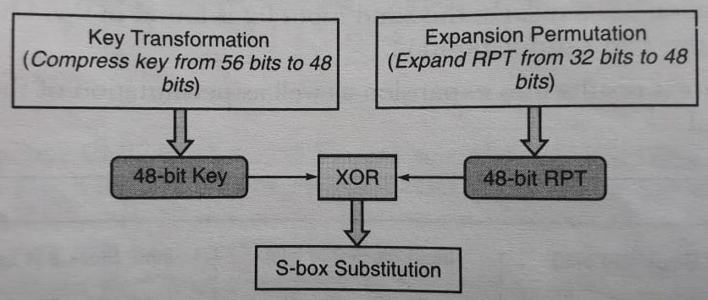
Way to S-Box Substitution

Slide 10
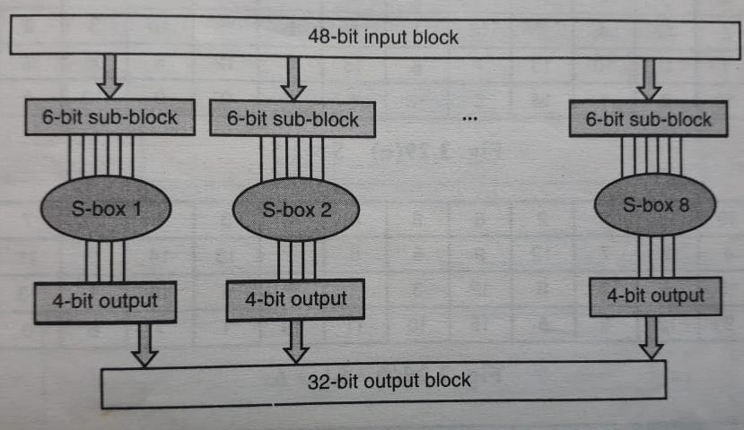
S-Box Substitution

Slide 11
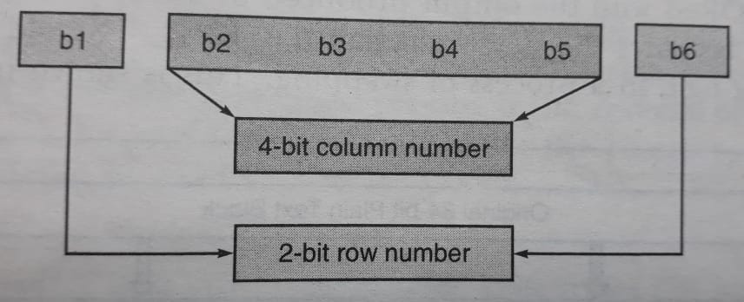
Selecting An Entry In A S-box Based On 6-bit Input

Slide 12
P-Box Permutation
It is the replacement of each bit with another bit following the predetermined P-box.

Slide 13
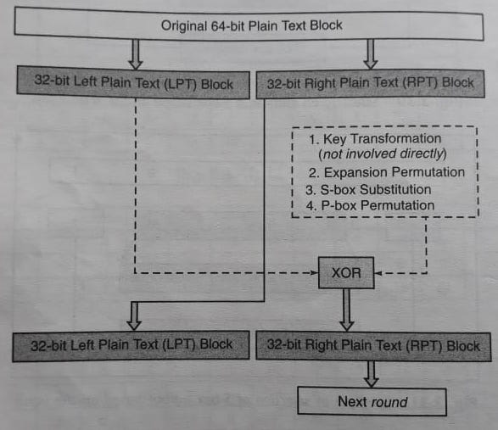
XOR and Swap

Slide 14
Final Permutation
At the end of the 16 rounds Final Permutation is performed using a predefined table called FP table.

Slide 15
Next Topic
Variations of DES

Slide 16
Thank you
Notes:
Is your presentation as crisp as possible? Consider moving extra content to the appendix.
Use appendix slides to store content that you might want to refer to during the Question slide or that may be useful for attendees to investigate deeper in the future.

